Slide 1






CAMPUS SYNC Unified Campus Management System
Aman Patel (24SCSE1260003)
TEAM MEMBERS
Shobhit (24SCSE1290006)
Alok Shaw (24SCSE1290023)
JSP • Servlets • MySQL • Java
R1UC304C

Slide 2
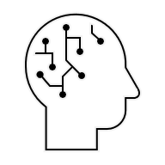
CONTENTS OF THIS PROJECT
1. Efficient Campus Operations
A well-organized campus management system is essential for educational institutions to handle academic and administrative tasks smoothly. It ensures faster communication, accurate record-keeping, and a more systematic workflow across departments.
2. Automation and Accuracy in Academics
A digital solution like CampusSync reduces manual workload, minimizes errors, and improves the quality of services provided to students and faculty. It enhances academic efficiency by automating attendance, assignments, and user management.
3.Technological Advancement in Education
Our project, CampusSync, is developed using Java, Servlets, JSP, JDBC, and MySQL to simplify daily campus activities. The system makes academic operations faster, more accurate, and more reliable, addressing the growing need for digital tools in modern education.
4. Future-Ready Campus System
A computerized campus management platform prepares institutions for future needs by supporting scalability, advanced integrations, and expansion of new modules. It ensures long-term usability and helps institutions stay updated with evolving educational technologies.

Slide 3
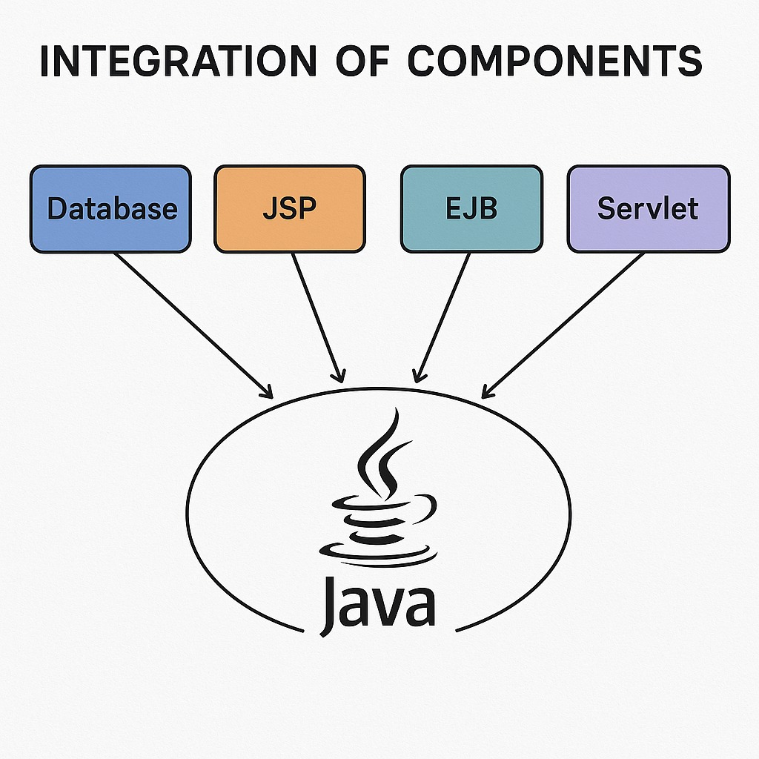
Implementation

Slide 4
01
CLIENT
02
JSP
03
SERVLET
04
DAO
05
DATABASE
06
KPI OVERVIEW
System Architecture & Core Technologies
User requests via browser
View renders request data
Controller processes input
Data access operations
Persistent storage
Retention Rate

Slide 5
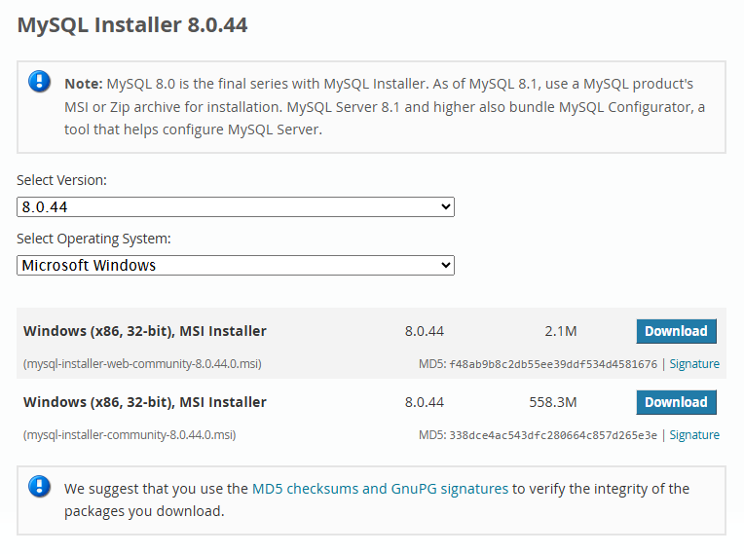
INSTALL MYSQL

Slide 6
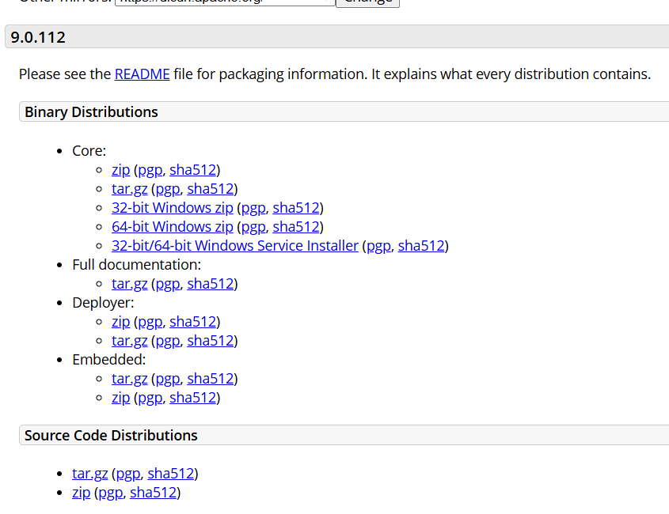
INSTALL TOMCAT

Slide 7
Admin
Faculty
Student
USE CASE OVERVIEW: ROLE-BASED INTERACTIONS
Manage students, faculty, notices
Manage attendance, marks, assignments
View attendance, marks, assignments
CampusSync caters to distinct user roles, providing tailored functionalities for administrators, faculty, and students.

Slide 8
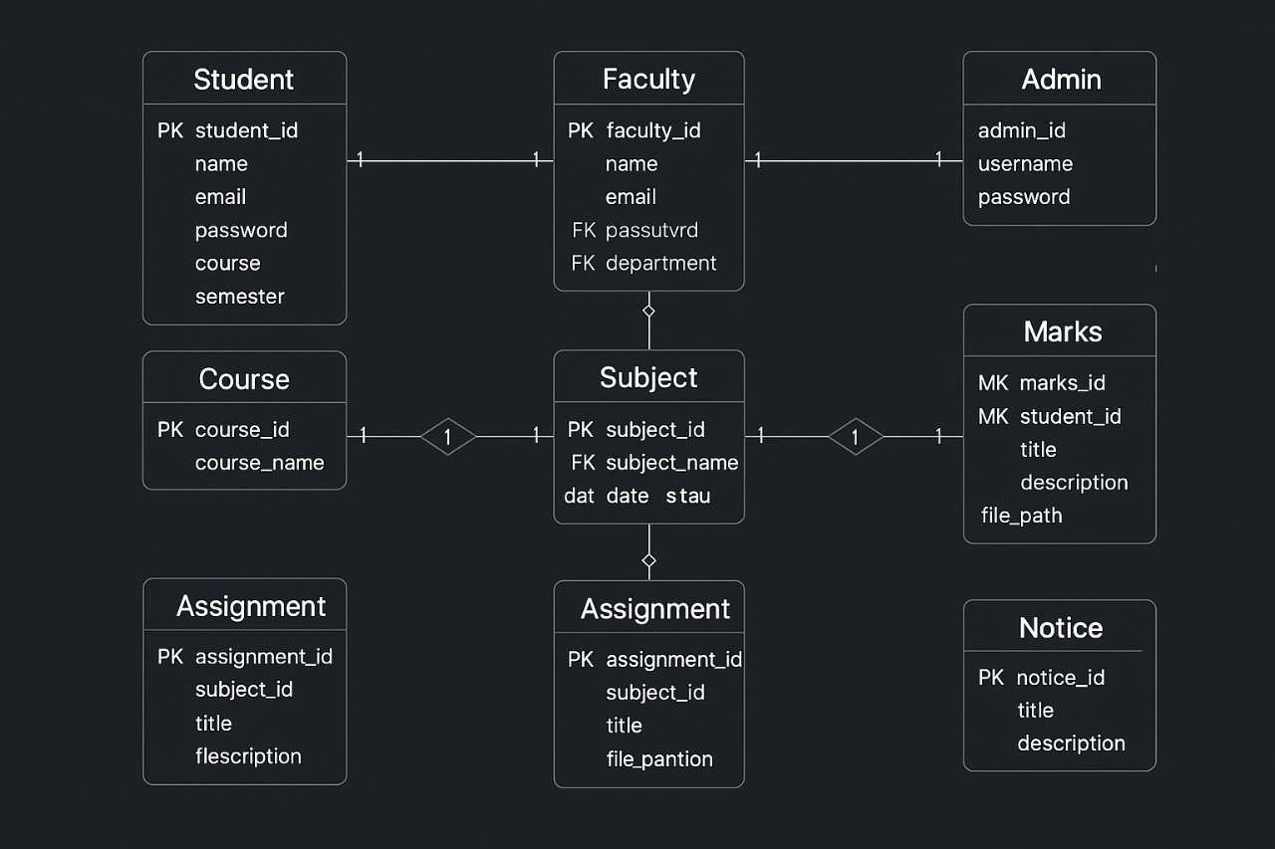
PROJECT STRUCTURE

Slide 9
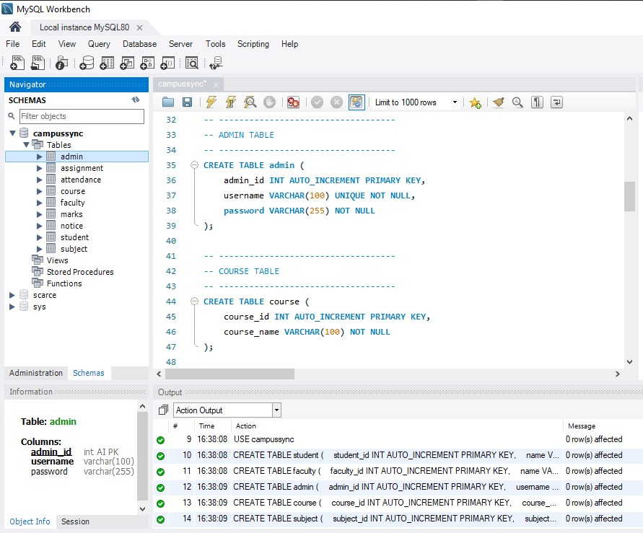
CREATE A MYSQL TABLE
The MySQL tables in the CampusSync system have been carefully designed and structured to ensure smooth execution of all academic and administrative operations. These tables efficiently store and manage essential information such as student records, faculty details, attendance logs, assignment data, and administrator credentials.

Slide 10
— J D B C (Java Database Connectivity)
IMPLEMENT JDBC CONNECTIVITY
// JDBC URL - use serverTimezone to avoid timezone warnings
private static final String URL = String.format( "jdbc:mysql://%s:%s/%s?useSSL=false&allowPublicKeyRetrieval=true&serverTimezone=UTC",
HOST, PORT, DBNAME);
CampusSync uses J D B C (Java Database Connectivity) to connect Java Servlets with the MySQL database. JDBC enables the application to store, retrieve, update, and manage academic data such as students, faculty, assignments, attendance, and admin details.

Slide 11
CampusSync
FacultyDAO
AdminDAO
AttendanceDAO
StudentDAO
AssignmentDAO
Develop Model and DAO Classes for Database Operations
The Data Access Object (DAO) is a design pattern used to separate low-level database operations from high-level business logic. In CampusSync, DAO acts as a bridge between Java Servlets and the MySQL database.
Venus is the second planet from the Sun
Uploading assignments, managing attendance
Login authentication, user management
Storing and retrieving attendance
Fetching student details, attendance, assignments
Handling assignment uploads/list

Slide 12
DAO Layer Workflow in CampusSync
 | FIRST QUARTER | SECOND QUARTER | THIRD QUARTER
KEY ACTION 1 | Servlet receives request | DAO creates a Prepared Statement | DAO maps data to Java Model class
KEY ACTION 2 | Servlet calls the appropriate DAO method | DAO executes SQL query Result Set returned to DAO | DAO returns model to Servlet and forwards data to JSP

Slide 13
AdminDAO
StudentDAO
FacultyDAO
STRUCTURED DATA MANAGEMENT
The DAO layer abstracts database operations, providing separation of concerns and enhancing maintainability.
Manages faculty,
student, and notice data.
Facilitates fetching attendance, marks, and assignment details for students.
Handles attendance, marks, and assignment submissions.

Slide 14
SERVLETS & WEB INTEGRATION
Servlets act as the backbone of CampusSync. They handle all incoming user requests, process business logic, communicate with the database, and send responses to the JSP pages.
A SERVLET PERFORMS:
Request handling (GET/POST)
Input validation
Role-based functionalities
Database interaction via DAO
Session management
Forwarding results to JSP
This makes Servlets the controller layer of the MVC architecture.

Slide 15
MAIN TERM
SUB TERM
MAJOR SERVLETS USED IN CAMPUSSYNC
STUDENT SERVLET 1
FACULTY SERVLET 2
ADMIN SERVLET 3
Performs login authentication
Validates user credentials
Creates sessions for each role (Student, Faculty, Admin)
Displays student dashboard
Fetches attendance records
Shows assignments
Allows faculty to upload
assignments
Mark attendance
AUTH SERVLET 4
ATTENDANCE SERVLET 5
ASSIGNMENT SERVLET 6
Performs login authentication
Validates user credentials
Creates sessions for each role (Student, Faculty, Admin)
Records attendance
Stores data into the attendance table
Uploads assignments
Retrieves assignment list
These servlets collectively support all major functionality of CampusSync.

Slide 16


REQUEST HANDLING (DOGET & DOPOST)
CampusSync uses both:
doGet() → To fetch data or display pages
doPost() → To submit forms like login, assignments, or attendance
EXAMPLE:
protected void doPost(HttpServletRequest request, HttpServletResponse response)
throws ServletException, IOException {
String email = request.getParameter("email");
String password = request.getParameter("password");
}
Z

Slide 17


UI DESIGN AND AESTHETICS
1. PROFESSIONAL ACADEMIC-THEMED BACKGROUND
A clean, subtle campus-themed background (such as classroom, college silhouette, or abstract blue academic gradient) enhances the professional look of the application. It immediately gives users a university environment feel, making the platform visually relevant and engaging.
2. CLEAN AND MODERN TYPOGRAPHY
Headings are displayed using bold, modern sans-serif fonts (like Poppins or Roboto), ensuring excellent readability. Subheadings and body text use lighter font weights, maintaining a visual hierarchy across all screens.
3. REALISTIC CAMPUS MANAGEMENT FEEL
Just like a real university portal:
Dashboard greetings
Quick stats cards
Profile icon
Logout button all create a realistic, professional academic management experience.

Slide 18
UI COMPONENT ALIGNMENT
GOAL
KEY ACTION 1
KEY ACTION 2
1
2
3
4
Consistent Layout Structure
Perfect Horizontal Alignment
Vertical Alignment for Flow
Icon + Text Alignment
The UI follows a clean two-section layout:
Left Side Navigation Panel (fixed)
Right Side Content Area (dynamic)
All dashboard cards (Faculty, Students, Subjects) are perfectly aligned in a straight row with:
Equal spacing
Equal card size
Identical padding
Sections like Upcoming Classes are vertically aligned
Heading Table Rows &Columns
This alignment ensures smooth reading flow from top to bottom.
Each menu item has:
Left-aligned icon
Right-aligned label
Equal spacing between all items
This improves clarity and visual grouping.

Slide 19

RESPONSIVENESS AND ACCESSIBILITY
Flexible Grid-Based Layout
1
The UI follows a flexible grid structure, allowing elements like dashboards, tables, and cards to resize and realign naturally.
2
Accessibility for All Users
The interface uses:
Clear labels
High-contrast colors
Large clickable buttons .
Mobile-Friendly Navigation
3
Even though CampusSync is primarily desktop-oriented, the UI ensures that core pages.
4
Keyboard-Friendly UI
This improves usability for users who rely on keyboard input instead of a mouse.

Slide 20


